Slide 1
Programming Constructs
Ibtisam Mogul
Notes:
https://www.youtube.com/watch?v=G41G_PEWFjE

Slide 2
CONTENTS
Algorithm
SEQUENCE, SELECTION, ITERATION
Flowchart
If else

Slide 3
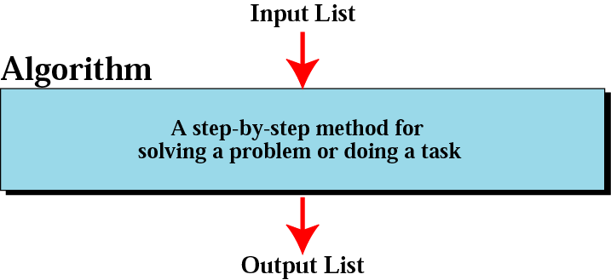
Figure 8-1
Algorithm

Slide 4
Example 1
Write an algorithm that will
read the two sides of a rectangle and
calculate its area.

Slide 5
Example 1
Algorithm
Input the Width (W) and Length (L) of a rectangle
Calculate the area (A) by multiplying L with W
Print A
Algorithm
Step 1: Input W,L
Step 2: A = L x W
Step 3: Print A

Slide 6
Flowcharts
Graphically depict the logical steps(algorithms) to carry out a task and
show how the steps relate to each other.

Slide 7
Flowchart Symbols

Slide 8
Example 1
START
Input
W, L
Algorithm
Step 1: Input W,L
Step 2: A ← L x W
Step 3: Print A
A ← L x W
Print A
STOP

Slide 9
FLOW CONTROL
In a program, statements may be executed
Sequentially
Selectively or
Iteratively.

Slide 10
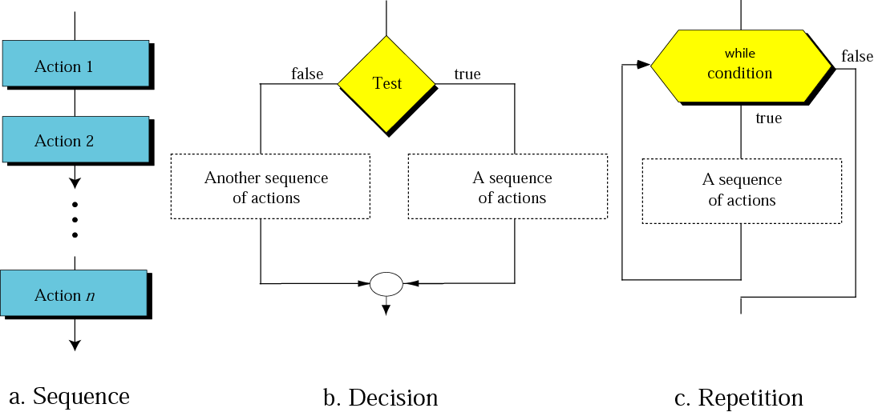
Figure 8-7
Flowcharts for three constructs
Test

Slide 11
A. SEQUENCE
Sequence construct mean statements are executed sequentially.
Every program begins with the first statement .
Each statement in turn executed sequentially.
when the final statement of program is executed, the program is done.

Slide 12
THE SEQUENCE CONSTRUCT
Statement 1
Statement 2
Statement 3

Slide 13
A. SEQUENCE CONSTRUCT
START
Statement 1
Input
W, L
Statement 2
A ← L x W
Statement 3
Print A
STOP

Slide 14
B. SELECTION
Selection construct means the execution of statement(s) depending upon a condition-test.
If a condition evaluates to true,
a course-of-action (a set of statements) is followed
otherwise another course-of-action (a different set of statements).
selection construct is also called decision construct because it helps in making decision about which set-of-statements is to be executed.

Slide 15
Conditional Statements
So far statements of our programs execute
Sequentially- one after another.
What happens when
we want to execute a statement depending on a condition?
e.g.
If A>B
then print A
Else print B
we want to execute one statement when a condition is true and
another statement when a condition is not true.
You achieve conditional execution with if-else statements

Slide 16
Two Way Decisions
X = 4
Sometimes we want to do one thing if a logical expression is true and something else if the expression is false
It is like a fork in the road - we must choose one or the other path but not both
no
x > 2
yes
print 'Not bigger'
print 'Bigger'
print 'All Done'

Slide 17
Two-way using else :
X = 4
x = 4;
if (x > 2)
print “Bigger‘’;
else
print “Smaller”;
print “All done”;
no
x > 2
yes
print 'Smaller'
print 'Bigger'
print 'All Done'

Slide 18
B. SELECTION CONSTRUCT., Flowchart Notation
Condition ?
False
Statement 1
Statement 2
True
Statement 3
Statement 4
Statement 4

Slide 19
Programming Syntax
if (condition)
{
statement_true_1;
...
statement_true_N;
}
else
{
statement_false_1;
...
statement_false_N;
}
If condition is TRUE then
statement_true_1 …
statement_true_N
are executed,
if condition is FALSE
statement_false_1 …
statement_false_N
are executed.
if (condition)
{
statement_true_1;
..
statement_true_N;
}
else and statement_false’s are optional
if condition is FALSE then nothing will be executed and execution continues with the next statement in the program
(condition) must be in brackets

Slide 20
Flow diagram of if-else
test condition
true
false
true
statements
false
statements
next
statement
Notes:
Loops start with testing a condition first: if the condition is false, the loop exits and moves to the next statement. If the condition is true, the loop statements execute and move to the beginning of the loop. This continues until the condition becomes false. Hence this enables the repetition of the loop statements.

Slide 21
if-else example
Write a program that inputs two integer numbers and displays the maximum one.

Slide 22
IF–THEN–ELSE STRUCTURE
The algorithm for finding greater number is:
If A>B then
print A
else
print B
endif
is
A>B
Y
N
Print A
Print B

Slide 23
Program FORMAT:IF - ELSE
if (condition)
{
Statement 1
Statement 2
}
else
{
Statement 1
Statement 2
}

Slide 24
Program Example of if statement
Example 1:
if (age>18)
MessageBox.Show(“The person is eligible for vote”);

Slide 25
Example of if-else
If (basic>8000)
{
total_da=(40*basic)/100 ;
gross=total_da + basic ;
}
else
{
total_da=(20*basic)/100;
gross=total_da + basic ;
}

Slide 26
Task
Write
an algorithm,
flowchart and
program
for finding if a number is even or odd
Use remainder logic (mod operator)

Slide 27
Any Q???

